Slide 1
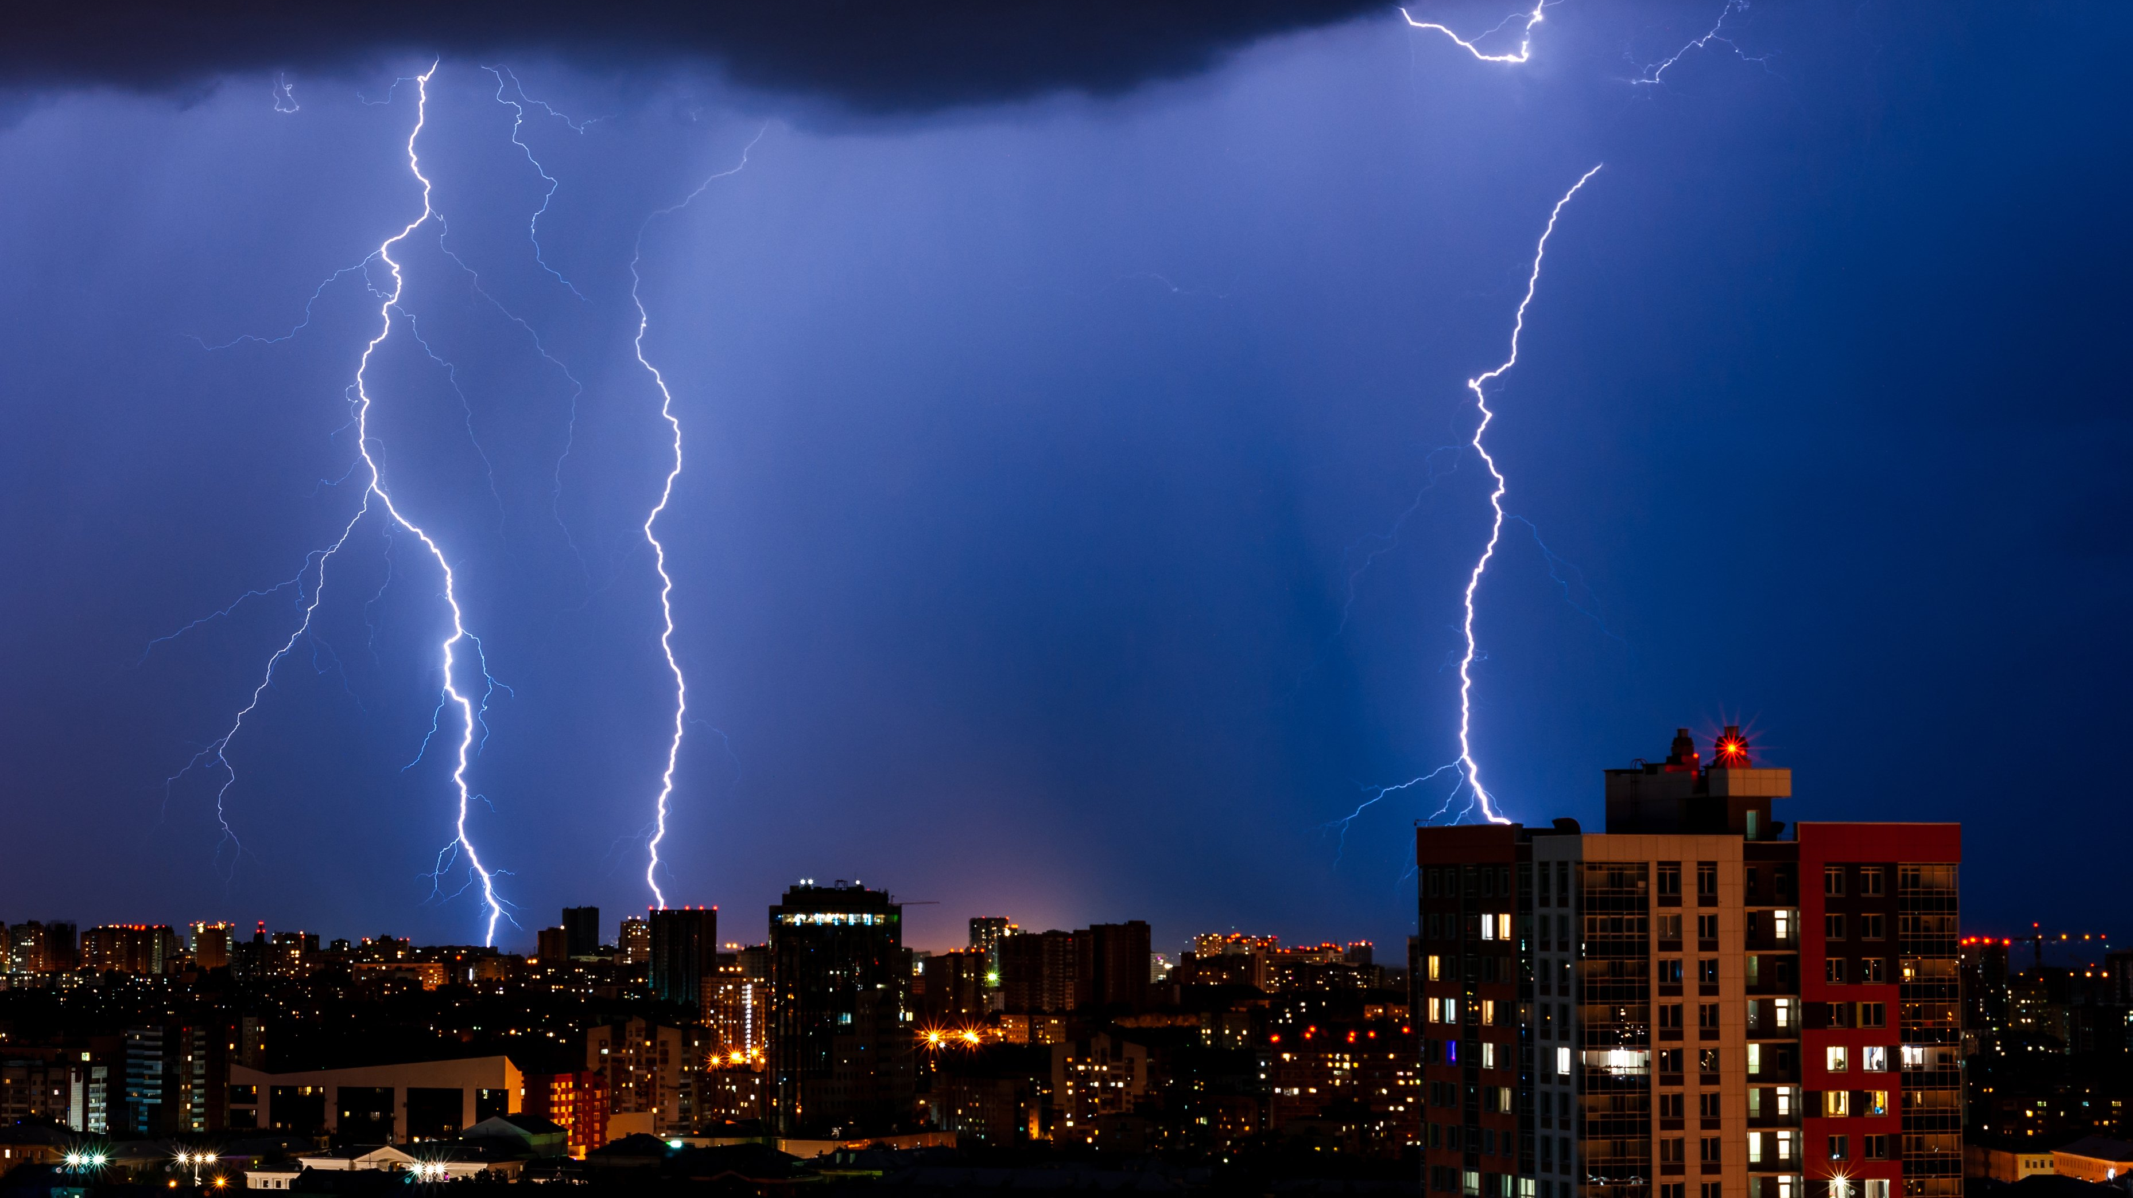
Lightning Strike Prediction Model
A Machine Learning & Clustering-Based Spatial Risk Prediction and Visualization System

Slide 2

Introduction
🌩️ Lightning is a powerful and unpredictable natural phenomenon that poses serious risks to life, infrastructure, and the environment. Accurate lightning prediction and early warning systems are critical to reducing these risks, especially in densely populated or high-risk regions.
📊 In recent years, Machine Learning (ML) and Deep Learning techniques have shown great promise in weather-related event prediction by learning complex patterns from large volumes of environmental data.
🧠 In this project, we harness these techniques to build an intelligent system capable of identifying lightning strike-prone zones and predicting the severity of strikes based on key atmospheric variables.
📌 Our approach leverages:
K-Means Clustering to detect spatial hot zones based on geographic coordinates (latitude and longitude).
A Convolutional Neural Network (CNN) trained on environmental features like temperature, humidity, wind speed, and air pressure to classify whether a strike occurs in a high-risk zone (Red).
✅ System includes unsupervised clustering for risk zoning and CNN-based severity prediction using meteorological parameters.
🗺️ Additionally, an interactive web dashboard is developed using Python and Leaflet.js to visually represent lightning strike patterns and risk zones, making the system accessible and actionable for emergency responders, meteorologists, and the public.

Slide 3
Literature Survey
🔎 Various studies have explored lightning prediction through satellite data, real-time sensors, and supervised machine learning. Key contributions include:
Kim et al. (2021): Supervised learning on Vaisala data for lightning risk zones.
Betz et al. (2019): LINET system for real-time lightning detection.
Cecil et al. (2014): Global lightning climatology using TRMM data.
Chronis et al. (2015): Machine learning with satellite-based lightning rate estimation.
Khan et al. (2021): Theoretical modeling of energy harnessing from lightning.
🧠 Research Gaps Identified:
Most prior studies do not utilize clustering techniques like K-Means to spatially classify lightning-prone regions.
Few models use deep learning architectures such as CNNs for severity prediction based on meteorological variables.
Limited work exists on integrating predictive analytics with real-time web-based dashboards for public access.
📌 Our system addresses these gaps by combining clustering, CNN prediction, and interactive web visualization — enabling both scientific accuracy and real-world usability.

Slide 4
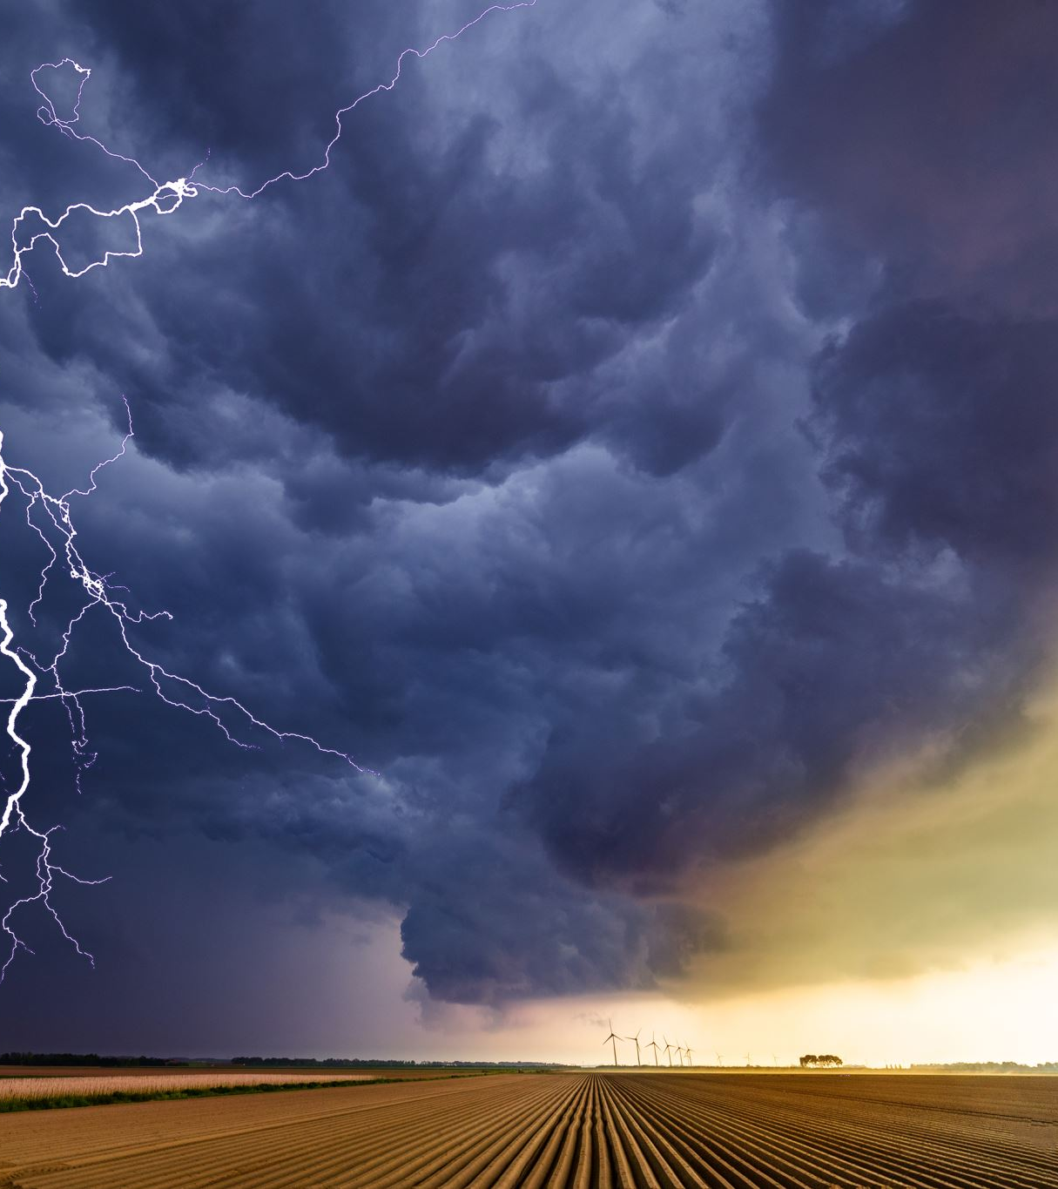
Gap Identification of present resources
Absence of accurate real-time predictions for lightning strikes poses safety risks.
Existing models fall short in providing precise, location-specific alerts.
Continuous dataset updates are required to reflect real-time weather conditions effectively.
Difficulty in seamlessly integrating diverse data sources for reliable predictions.
Balancing the need for timely alerts with maintaining high prediction accuracy.

Slide 5

Research Gaps
Despite significant advancements in lightning detection and prediction, several limitations persist in existing research and systems:
⚠️ Lack of Real-Time Interfaces Most studies provide offline predictions without offering interactive platforms for real-time public access or emergency decision-making.
🧭 Absence of Spatial Clustering Few models utilize spatial clustering (e.g., K-Means) to identify high-risk lightning zones, limiting geographic interpretability and region-specific insights.
🌦️ Dependence on Static Weather Data Many approaches rely solely on historical or averaged meteorological data, ignoring dynamic temporal variations that are critical for real-time forecasting.
📌 Our system addresses these gaps by integrating:
K-Means clustering for lightning hot zone detection
CNN-based severity classification using dynamic weather features
An interactive web dashboard for real-time visualization and accessibility

Slide 6
Objectives
The primary objectives of this research project are:
📍 Cluster lightning zones using spatial clustering
Apply K-Means clustering on latitude and longitude to classify strike-prone areas into Red (high risk), Orange (moderate), and Yellow (low risk) zones.
🧠 Predict high-risk lightning strikes
Train a Convolutional Neural Network (CNN) to classify whether a strike occurs in a high-risk (Red) zone using features such as:
Temperature
Air Pressure
Wind Speed
Humidity
Altitude
Time (hour/month)
🌐 Develop an interactive lightning monitoring system
Build a web-based dashboard using HTML, Leaflet.js, and Python (Flask) to:
Visualize clustered lightning zones on an interactive map
Display real-time strike trends and severity zones
Enable alerts and public access for emergency awareness

Slide 7

Methodology
Our lightning prediction and visualization pipeline consists of the following key stages:
1️⃣ Data Collection
3️⃣ Clustering – Risk Zone Detection
5️⃣ Reverse Geocoding
2️⃣ Data Cleaning &
4️⃣ CNN-Based Classification Model
6️⃣ Web Dashboard Integration
📌 This multi-stage pipeline bridges data analysis, ML prediction, and public accessibility through visual tools.

Slide 8
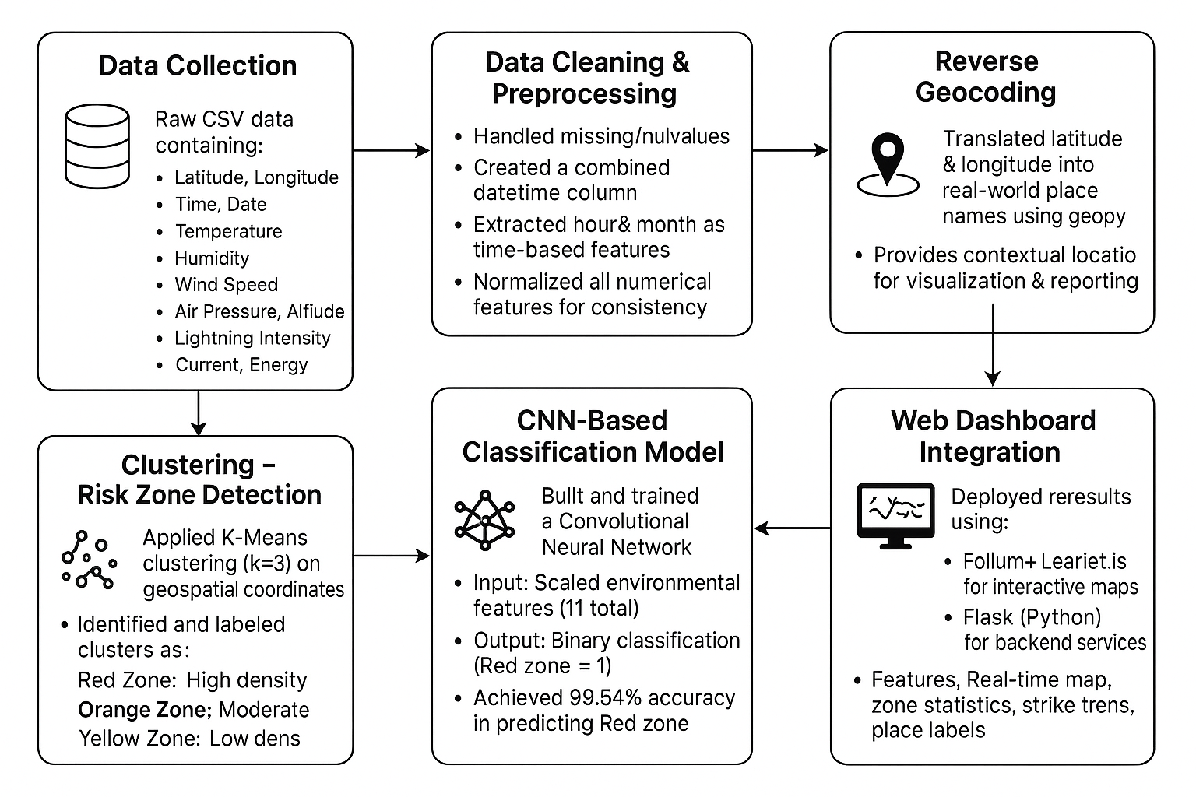

Slide 9
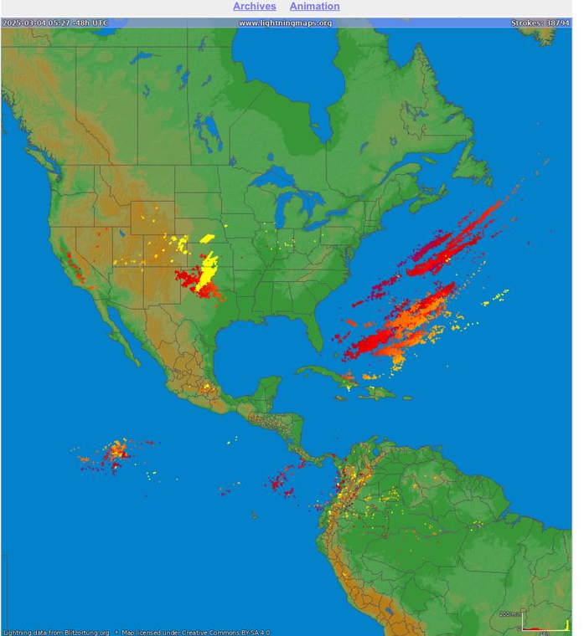
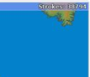
Q. Why require Machine Learning if we have direct Longitudinal and latitudinal data?
This is so because we not just want a historical data to predict for a single time but also to know about present weather scenario and update it in data set, as the amount of data increases exponentially. The exponential rate can be seen from an example of --- Edmund [near Tulsa USA] and Atlantic Ocean felt lightning strike count as 38,000+ in last 48 hours. This shows that the data needs to be updated as frequently as possible for more accuracy which traditional researches lack.

Slide 10
Work Done
Spatial Clustering
Applied K-Means algorithm to geospatial coordinates (latitude, longitude)
Classified lightning strike regions into 3 zones: • Red – High-risk • Orange – Moderate-risk • Yellow – Low-risk
✅ CNN Model Development
Built a Convolutional Neural Network using TensorFlow/Keras
Trained on environmental and temporal features (e.g., temperature, humidity, wind, hour)
Achieved 99.54% accuracy in predicting high-risk Red zone strikes
✅ Interactive Lightning Map
Created real-time geospatial map using Folium and Leaflet.js
Displayed color-coded strike zones with popup location info
Integrated strike frequency, hourly trends, and zone stats
✅ Web-Based Deployment
Developed backend using Python Flask framework
Hosted dashboard locally to simulate real-time alerts
Made results accessible via browser for visualization and decision-making

Slide 11
Results and Findings
Category | Details
Model Accuracy | 99.54%
Task | Predict whether a lightning strike occurs in a high-risk (Red) zone
Performance Metrics | Precision: 0.99 Recall: 0.99 F1-Score: 0.99
Model Strengths | High true positive rate with minimal false classifications
Confusion Matrix | Displayed to highlight model performance Shows strong prediction accuracy for Red and Non-Red zones
Zone Distribution (Pie Chart) | Red Zone: 47% of strikes (most frequent) Orange Zone: ~34% Yellow Zone: ~19%
Hourly Strike Trend (Bar Graph) | Peak lightning activity between 2 PM and 5 PM Indicates high convective storm activity in afternoon
Insight | Strong predictive capabilities with interpretable visualizations; actionable for meteorologists and emergency responders

Slide 12
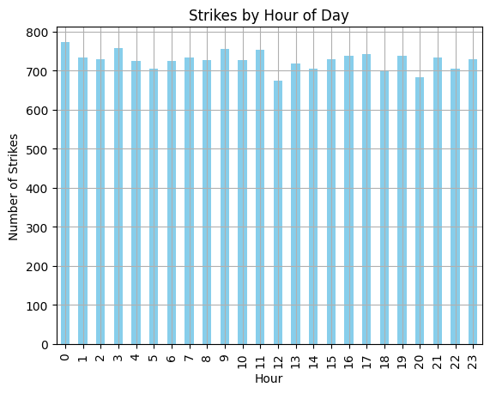
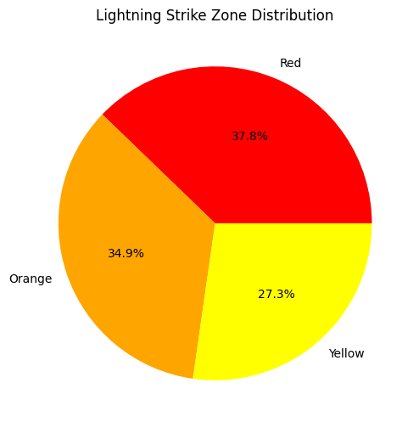
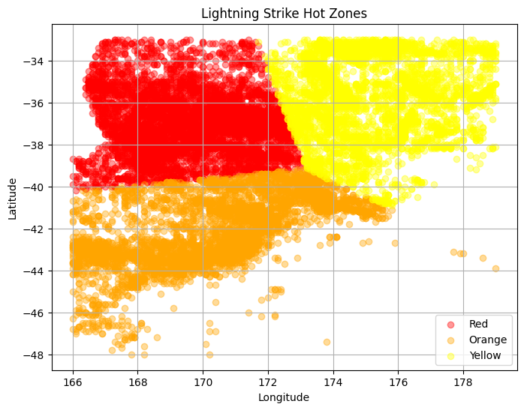
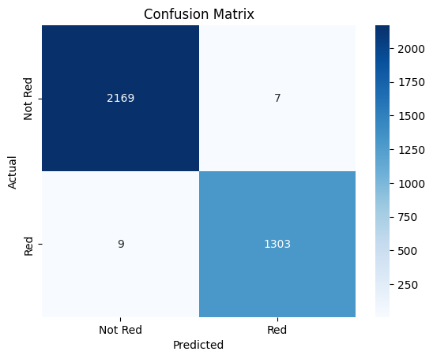

Slide 13

Web Integration & Deployment
Frontend Technologies
Developed using HTML, CSS, and Leaflet.js
Integrated Folium-generated maps for zone visualization
Features: • Color-coded strike zones (Red, Orange, Yellow) • Interactive markers with popup place names • Embedded charts (pie, bar) for trends and distribution
Backend Technologies
Implemented using Flask (Python)
Processes model outputs and serves them via web routes
Dynamically updates maps and statistics from the processed dataset
Real-Time Visualization & Alerts
Users can view lightning-prone areas categorized by risk level
Enables monitoring of lightning trends hour-by-hour
Reverse-geocoded place names provide real-world location context
Dashboard Highlights
Map View: Interactive global map with strike zones
Charts View: Zone distribution and hourly strike trend visualizations
Alerts Panel: Key insights and risk summaries
Hosted locally for demonstration; scalable for online/public deployment

Slide 14
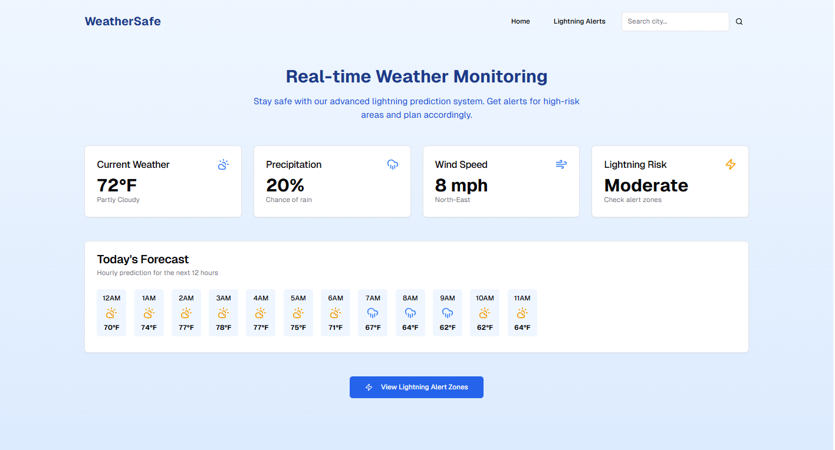

Slide 15
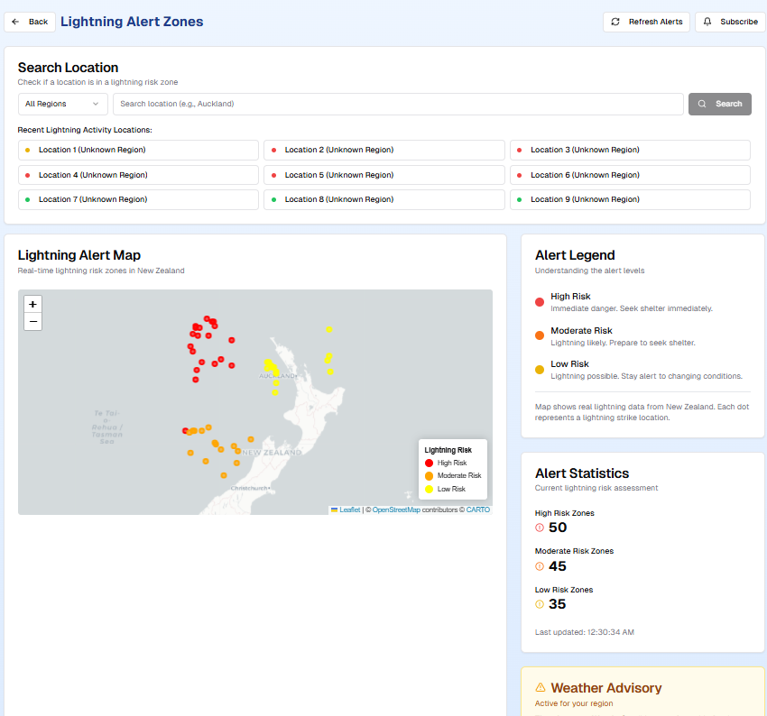

Slide 16
Conclusion
This project successfully demonstrates the use of machine learning and deep learning techniques for lightning risk assessment and real-time monitoring.
Key Achievements:
Achieved 99.54% accuracy in classifying high-risk Red zone lightning events using a Convolutional Neural Network (CNN)
Effectively identified lightning-prone regions via spatial clustering (K-Means)
Reverse-geocoded coordinates to provide real-world context for lightning strike locations
Interactive Visualization:
Developed a dynamic web dashboard with: • Real-time interactive maps (Leaflet.js + Folium) • Risk zone overlays (Red, Orange, Yellow) • Integrated bar charts and pie charts for trends and summaries
Real-World Impact:
Web-based system improves accessibility and public awareness
Scalable for use in emergency response, weather monitoring agencies, and hazard mitigation planning
Capable of being extended to live data pipelines, weather APIs, or mobile alert systems
Conclusion:
This system combines predictive accuracy, geographic interpretability, and interactive accessibility—marking a step toward smarter, data-driven lightning forecasting and public safety solutions.

Slide 17

References
Sources:
S.1: https://www.vaisala.com/en/lp/request-vaisala-lightning-data-research-use
S.2: https://www.weatherbug.com/alerts/spark
https://www.nssl.noaa.gov/education/svrwx101/lightning/detection/
Research Papers:
R.1: https://consensus.app/papers/nowcasting-lightning-occurrence-from-commonly-available-mostajabi-finney/d296481e2bf657af8cbb267e64b122f8/
R.2: https://consensus.app/papers/supervised-learningbased-prediction-of-lightning-shin-kim/3d1d269a14d051468b3156195dfdb79b/
R.3: https://consensus.app/papers/an-artificial-neural-network-for-lightning-prediction-bao-zhang/231ae31ae9035ac3b140abcc25142f35/

Slide 18


